Slide 1
Spark Framework Hafizur Rahman
2017/11/28

Slide 2
About Me
Experience
Working in Japan for last 15 years
Working for Asurion from August, 2017
Qualifications
Sun Certified Enterprise Architect
EMC Certified Data Science Associate
Cloudera Certified Hadoop Administrator
O’Reilly Certified Spark Developer

Slide 3


Agenda
Big Data Analytics
Big Data Challenges
Spark Platform
Features
API
Architecture
Break 10~15 mins (tentatively around 3:00~)
Hands On
Notebook Style Development using Zeppelin
Exploratory Data Analysis using Spark API
Use some transformation and action methods
Visualization

Slide 4
Big Data Challenges

Slide 5

Data Generated Every Minute

Slide 6

Big Data Challenges
Data growing faster than computation speeds
Growing data sources
Web, mobile, IoT, scientific, …
Storage getting cheaper
Size doubling every 18 months
Cost of 1 TB of disk: ~$35
But, stalling CPU speeds and storage bottlenecks
Time to read 1 TB from disk: 3 hours (100 MB/s)

Slide 7
Big Data Challenges
Single node can't handle due to limited resource
Processor time, Memory, Hard drive space, Network bandwidth
Individual hard drives can only sustain read speeds between 60-100 MB/second, so multicore does not help that much
Multiple nodes needed, but probability of failure increases
Network failure, Data transfer failure, Node failure
Desynchronized clock, Lock
Partial failure in distributed atomic transaction
Links
Understanding the Big Data World
https://developer.yahoo.com/hadoop/tutorial/
Notes:
Shared storage is cost prohibitive

Slide 8
A Brief History

Slide 9
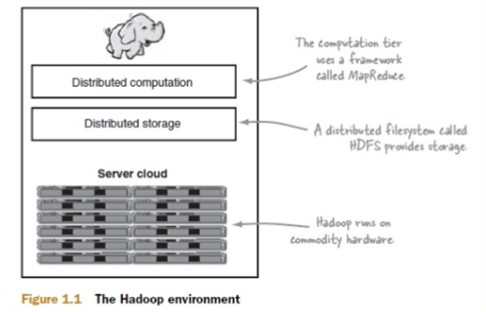
History: Hadoop 1.x

Slide 10
History: MapReduce Limitations
MapReduce use cases showed two major limitations:
difficultly of programming directly in MR
performance bottlenecks, or batch not fitting the use cases
In short, MR doesn’t compose well for large applications
Therefore, people built specialized systems as workarounds…
Notes:
https://hadoop.apache.org/docs/stable/hadoop-mapreduce-client/hadoop-mapreduce-client-core/MapReduceTutorial.html#Example:_WordCount_v1.0

Slide 11
Spark

Slide 12
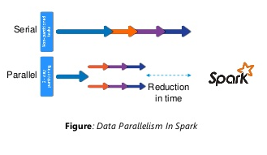
Spark Essentials: What is Spark?
Unlike the various specialized systems, Spark’s goal was to generalize MapReduce to support new apps within same engine
Two reasonably small additions are enough to express the previous models:
fast data sharing
general DAGs
This allows for an approach which is more efficient for the engine, and much simpler for the end users

Slide 13
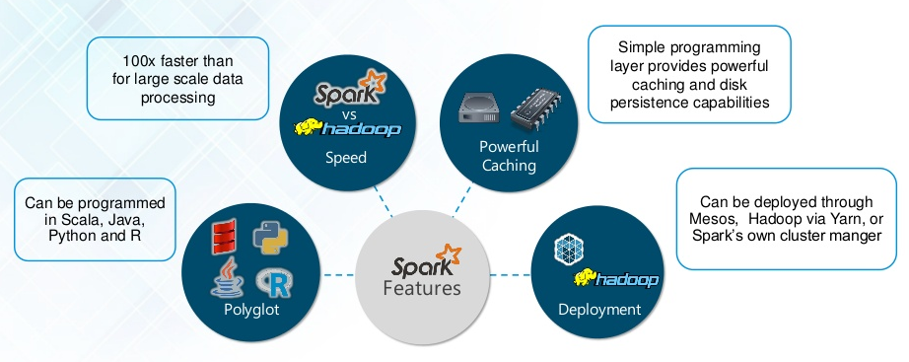
Spark Essentials: Why Spark?
Notes:
Polyglot:
Spark provides high-level APIs in Java, Scala, Python and R. Spark code can be written in any of these four languages. It provides a shell in Scala and Python. The Scala shell can be accessed through ./bin/spark-shell and Python shell through ./bin/pysparkfrom the installed directory.
Speed:
Spark runs up to 100 times faster than Hadoop MapReduce for large-scale data processing. Spark is able to achieve this speed through controlled partitioning. It manages data using partitions that help parallelize distributed data processing with minimal network traffic.
Multiple Formats:
Spark supports multiple data sources such as Parquet, JSON, Hive and Cassandra apart from the usual formats such as text files, CSV and RDBMS tables. The Data Source API provides a pluggable mechanism for accessing structured data though Spark SQL. Data sources can be more than just simple pipes that convert data and pull it into Spark.
Lazy Evaluation:
Apache Spark delays its evaluation till it is absolutely necessary. This is one of the key factors contributing to its speed. For transformations, Spark adds them to a DAG (Directed Acyclic Graph) of computation and only when the driver requests some data, does this DAG actually gets executed.
Hadoop Integration:
Apache Spark provides smooth compatibility with Hadoop. This is a boon for all the Big Data engineers who started their careers with Hadoop. Spark is a potential replacement for the MapReduce functions of Hadoop, while Spark has the ability to run on top of an existing Hadoop cluster using YARN for resource scheduling.
Machine Learning:
Spark’s MLlib is the machine learning component which is handy when it comes to big data processing. It eradicates the need to use multiple tools, one for processing and one for machine learning. Spark provides data engineers and data scientists with a powerful, unified engine that is both fast and easy to use.

Slide 14
Spark Essentials: Spark Features
Some key points about Spark:
Handles batch, interactive, and real-time within a single framework
Native integration with Java, Python, Scala, R
Programming at a higher level of abstraction
More general: map/reduce is just one set of supported constructs
Notes:
Provides programming abstraction and parallel runtime to hide complexities of fault-tolerance and slow machines
Faster execution platform for both iterative machine learning and interactive data analysis
Single stack for batch processing, SQL queries, real-time stream processing, graph processing, and complex data analytics
Provides high-level API to develop a diverse range of distributed applications by hiding the complexities of distributed programming
Seamless support for various data sources such as RDBMS, HBase, Cassandra, Parquet, MongoDB, HDFS, Amazon S3, and so on

Slide 15
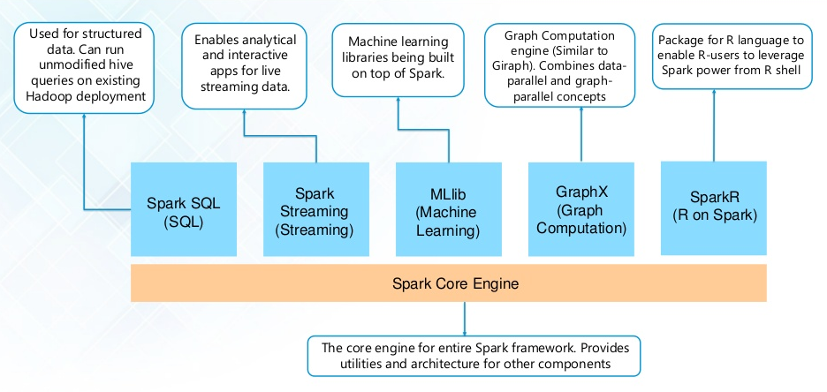
Spark Essentials: Spark Components
https://spark.apache.org/

Slide 16
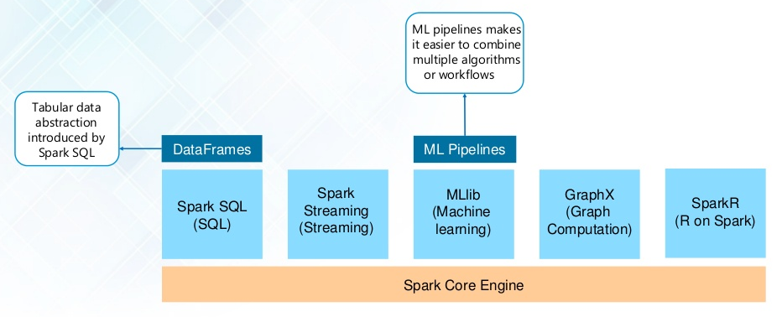
Spark Essentials: Spark Components

Slide 17
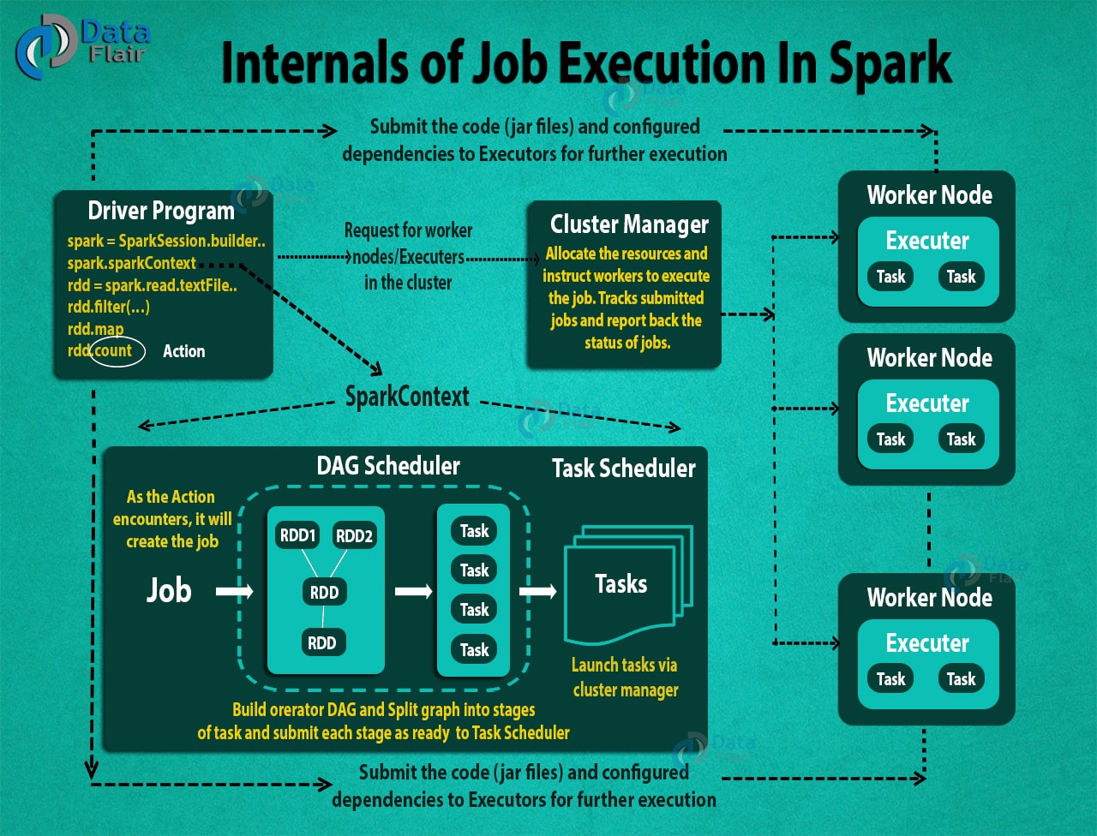
Spark Essentials: Spark Architecture
http://spark.apache.org/docs/latest/cluster-overview.html

Slide 18
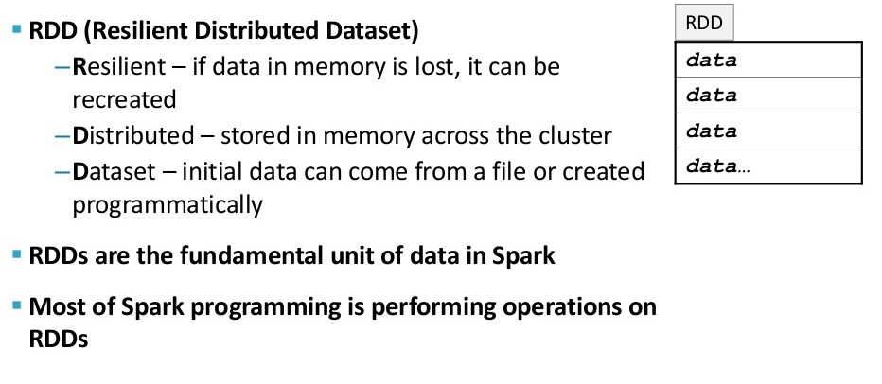
Spark Essentials: RDD (Resilient Distributed Dataset)

Slide 19
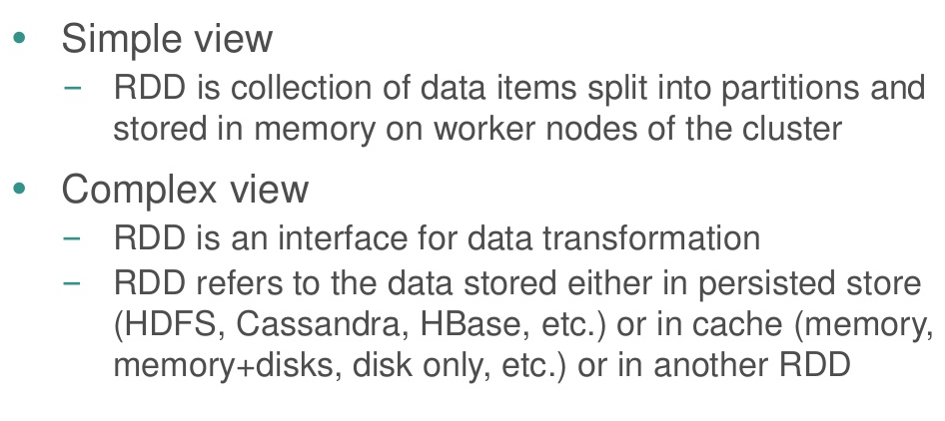
Spark Essentials: RDD

Slide 20
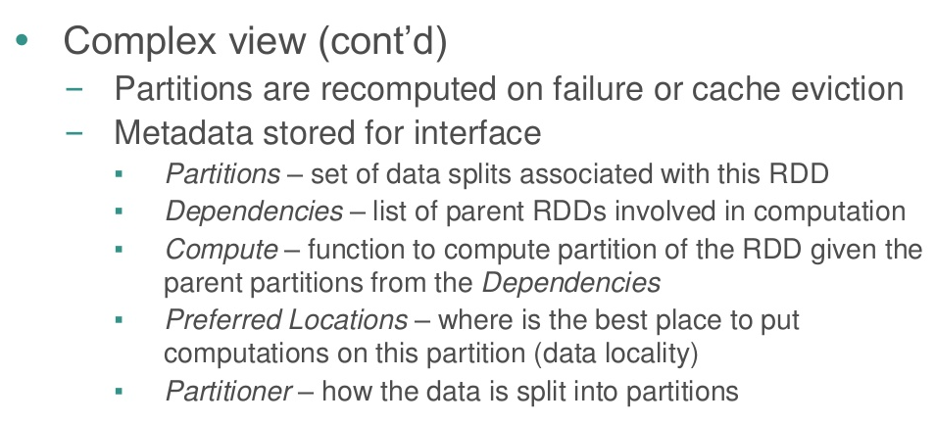
Spark Essentials: RDD

Slide 21
Spark Essentials: RDD

Slide 22
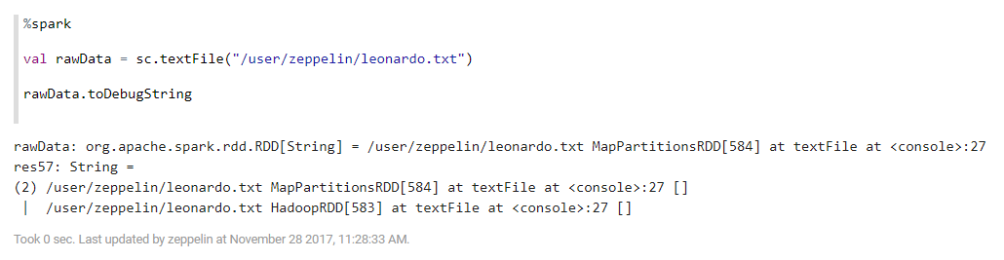
Spark Essentials: RDD

Slide 23
Spark Essentials: Transformation & Action
Transformations
Create new RDD from existing RDD like map, reduceByKey, filter
Executed on demand (lazy): they do not compute their results right away – instead they remember the transformations applied to some base dataset
optimize the required calculations
recover from lost data partitions
Actions
Return final results of RDD computations
Triggers execution using lineage graph to load the data into original RDD, carry out all intermediate transformations and return final results to Driver program or write it out to file system

Slide 24
Spark Essentials: RDD Transformation

Slide 25
Spark Essentials: RDD Transformation

Slide 26
Spark Essentials: RDD Action

Slide 27
Spark Essentials: RDD Action

Slide 28
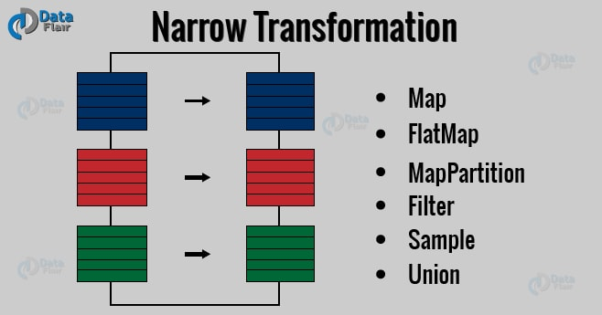
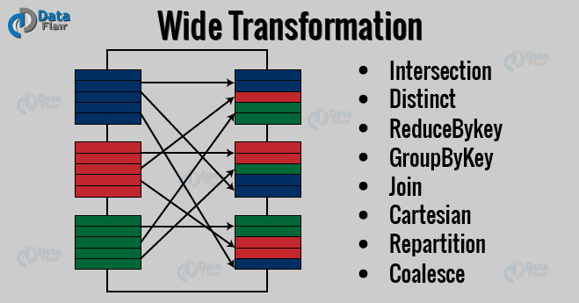
Spark Essentials: Types of Transformations
Narrow transformation
All the elements that are required to compute the records in single partition live in the single partition of parent RDD
Wide transformation
All the elements that are required to compute the records in the single partition may live in many partitions of parent RDD

Slide 29
Spark Essentials: Persistence
Spark can persist (or cache) a dataset in memory across operations
Each node stores in memory any slices of it that it computes and reuses them in other actions on that dataset – often making future actions more than 10x faster
The cache is fault-tolerant: if any partition of an RDD is lost, it will automatically be recomputed using the transformations that originally created it

Slide 30
Spark Essentials: Persistence

Slide 31
Spark Essentials: Persistence

Slide 32
Spark Essentials: Broadcast Variables
Broadcast variables let programmer keep a read-only variable cached on each machine rather than shipping a copy of it with tasks
For example, to give every node a copy of a large input dataset efficiently
Spark also attempts to distribute broadcast variables using efficient broadcast algorithms to reduce communication cost

Slide 33
Spark Essentials: Broadcast Variables

Slide 34
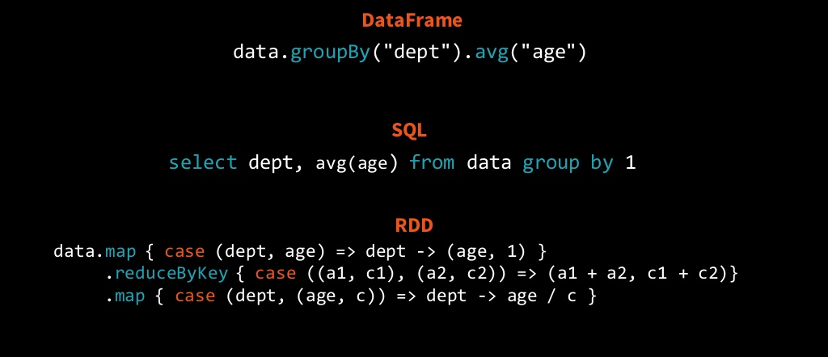
Spark Essentials: RDD Limitations
RDD Limitations
Slow with non-JVM languages such as Python
Can not be optimized by Spark
Difficult to understand what is going on

Slide 35
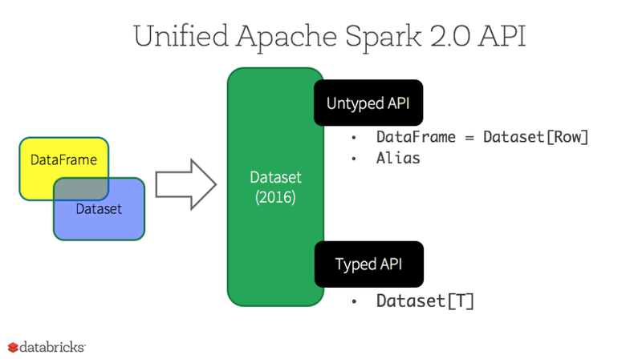
Spark Essentials: DataFrame and Dataset
DataFrame
Pros
Provides high level abstraction
Logical plan representing data and schema
Logical plan is transformed to physical plan during execution
Spark to figure out the most efficient way to do what you want to do
Custom memory management (project Tungsten)
Optimized execution plans (Catalyst optimizer)
Cons
Compile-time type safety is gone!
Dataset
Brings back the compile time type safety
Reference: DataFrames and Datasets

Slide 36
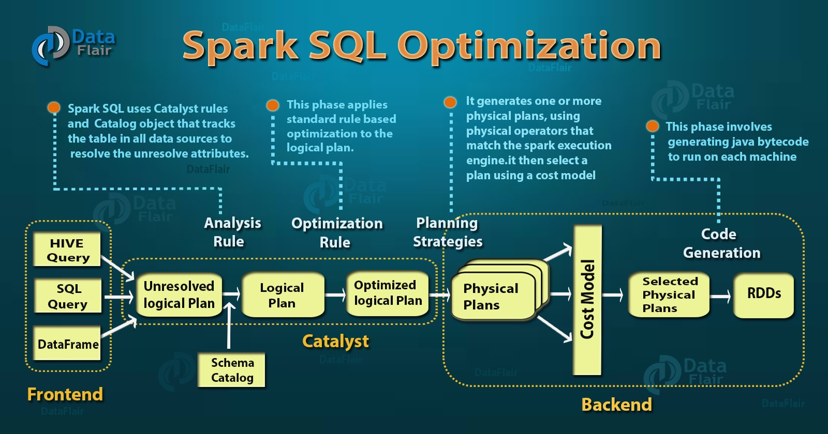
Spark Essentials: Spark SQL Optimization

Slide 37
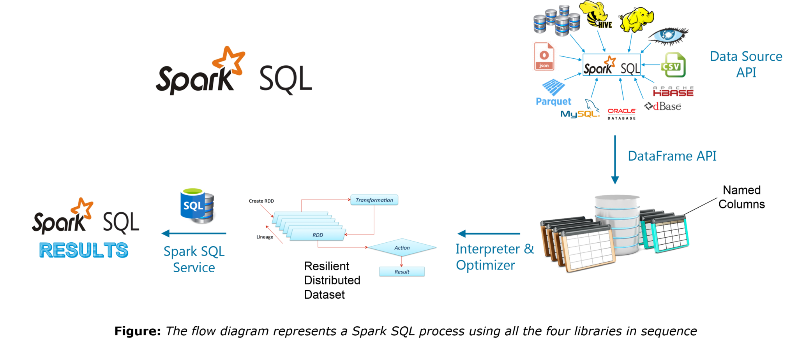
Spark Essentials: Spark SQL
Four libraries of Spark SQL
Data Source API
DataFrame API
Interpreter & Optimizer
SQL Service

Slide 38
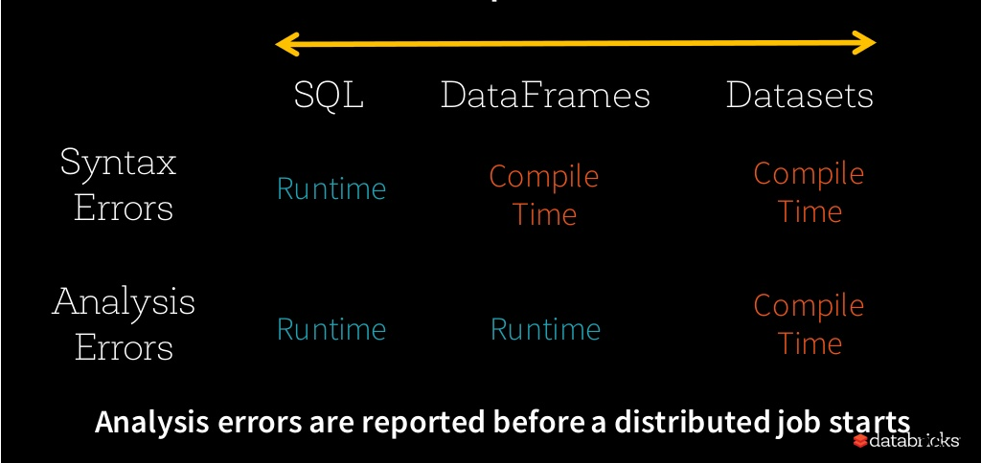
Spark Essentials: Structured APIs in Spark

Slide 39
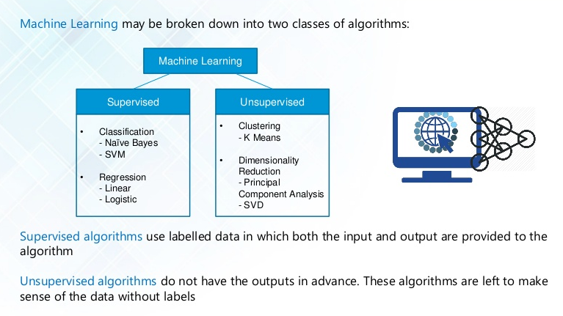
Spark Advanced: Machine Learning

Slide 40
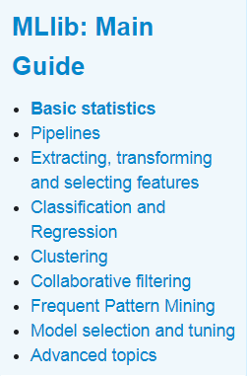
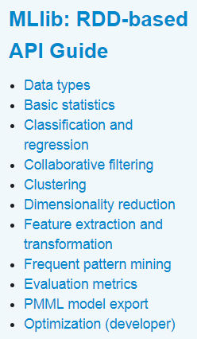
Spark Advanced: Spark MLlib
https://spark.apache.org/docs/latest/ml-statistics.html

Slide 41
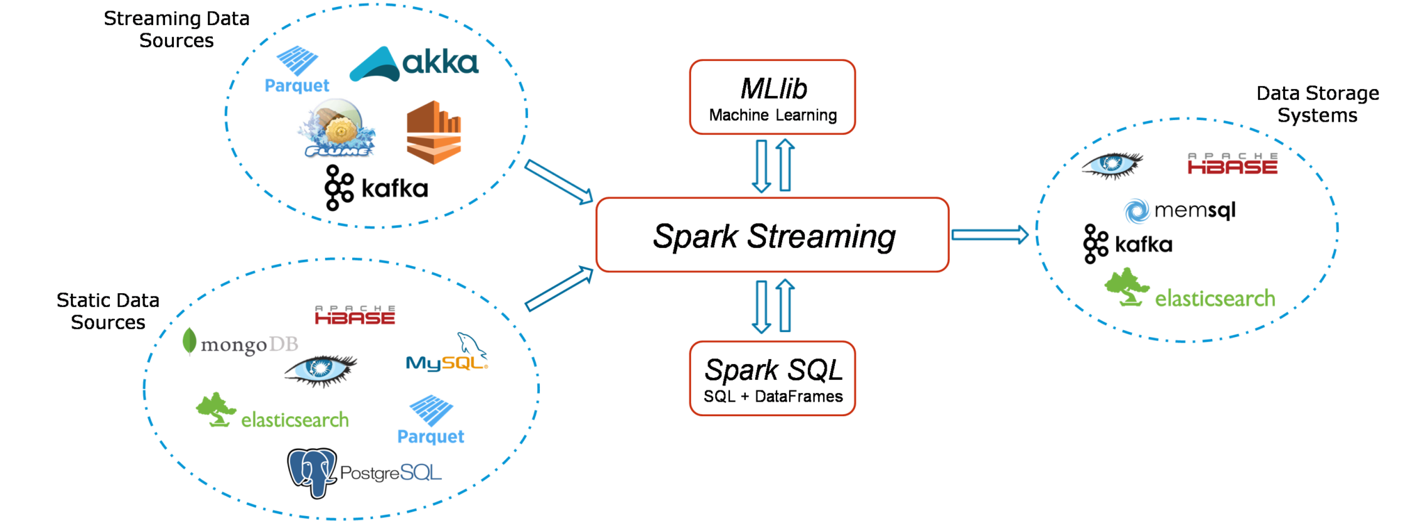
Spark Advanced: Spark Streaming

Slide 42
Spark Advanced: Deep Learning
Microsoft Machine Learning for Apache Spark (https://github.com/Azure/mmlspark)
DeepLearning4j (https://deeplearning4j.org/spark)
BigDL (https://bigdl-project.github.io/master/)
Tensorframes (https://github.com/databricks/tensorframes)

Slide 43
Resources
https://training.databricks.com/visualapi.pdf
http://nbviewer.jupyter.org/github/jkthompson/pyspark-pictures/blob/master/pyspark-pictures.ipynb
https://stanford.edu/~rezab/sparkclass/slides/itas_workshop.pdf
https://www.edureka.co/blog/spark-tutorial/
https://data-flair.training/blogs/apache-spark-for-beginners/
https://docs.databricks.com/spark/latest/training/index.html

Slide 44
Hands On
Zeppelin
RDD, Dataset
Action and Transformation methods
Spark SQL
Example Notebooks
https://github.com/hortonworks-gallery/zeppelin-notebooks

Slide 45
Backup

Slide 46
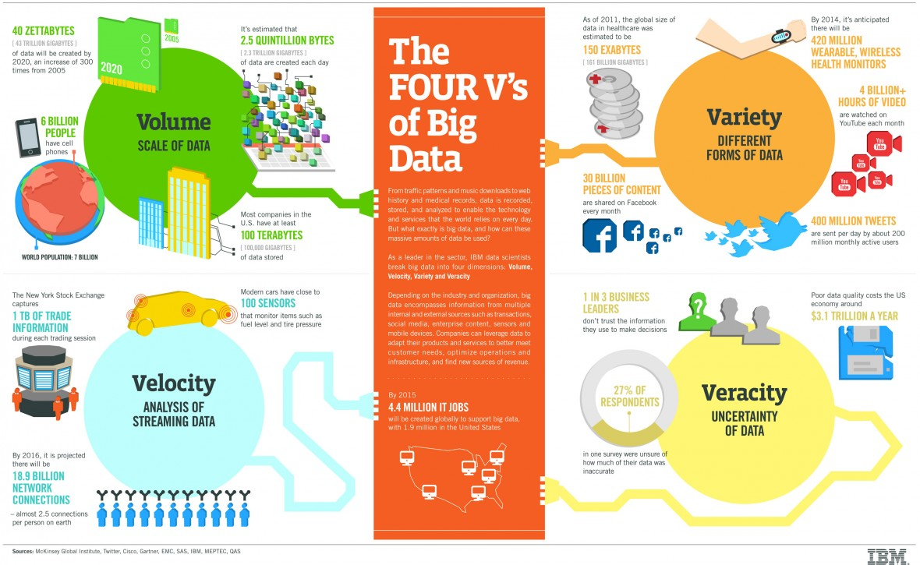
The Four V's of Big Data - IBM
Notes:
* 'Big Data' describes data sets so large and complex that it is impractical to manage with traditional software tools

Slide 47

Hadoop

Slide 48
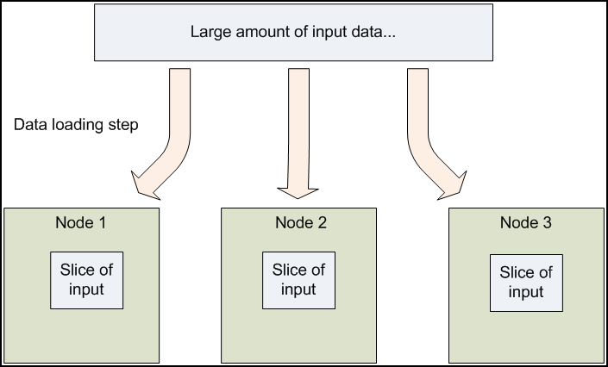
Hadoop 1.x Approach (1/4)
Data Distribution
Distributed to all the nodes in the cluster
Replicated to several nodes

Slide 49
Hadoop 1.x Approach (2/4)
Move computation to the data
Whenever possible, rather than moving data for processing, computation is moved to the node that contains the data
Most data is read from local disk straight into the CPU, alleviating strain on network bandwidth and preventing unnecessary network transfers
This data locality results in high performance

Slide 50
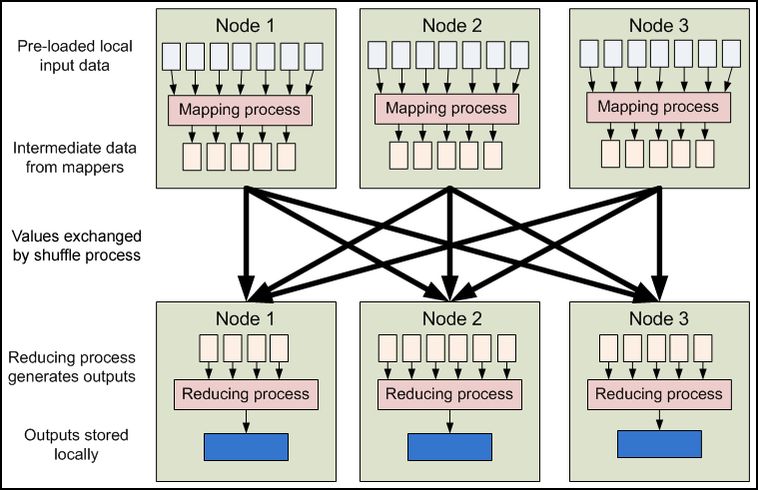
Hadoop 1.x Approach (3/4)
MapReduce programming model
Run as isolated process

Slide 51
Hadoop 1.x Approach (4/4)
Isolated execution
Communication between nodes is limited and done implicitly
Individual node failures can be worked around by restarting tasks on other nodes
No message exchange needed by user task
No roll back to pre-arranged checkpoints to partially restart the computation
Other workers continue to operate as though nothing went wrong

Slide 52
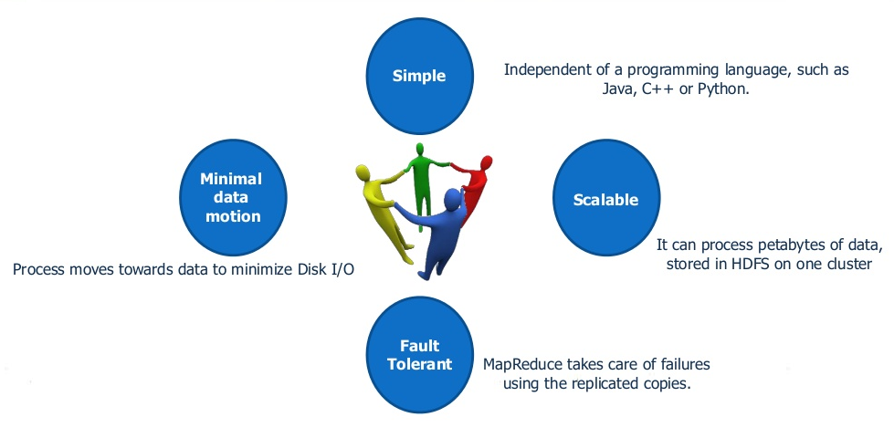
Strength of Hadoop MR

Slide 53
Traditional System vs Hadoop
Traditional | Hadoop
Schema-on-Read | Schema-on-Write
Shared Storage | Local Storage
Proprietary Hardware | Commodity Hardware
Complexity | Simplicity
Causation | Correlation
Bringing Data to the Programs | Bringing Programs to the Data
Reference: Understanding the Big Data World

Slide 54
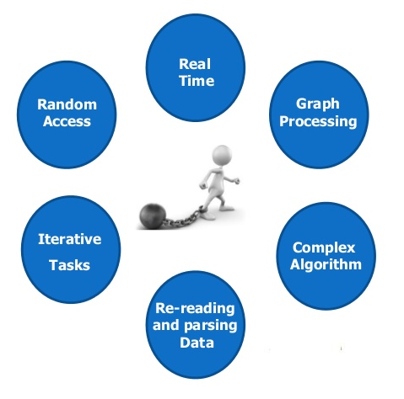
Hadoop MR Limitations

Slide 55
Hadoop MR Limitations
Hadoop 1.x solutions were best suited for only specific types of big data requirements such as ETL
Poor support for interactive application (ad-hoc query) and iterative algorithm
Every time query was executed, Data is read from the disk (HDFS-read) and loaded into the memory
Notes:
Since MapReduce had a restricted programming model with forbidden communication between Map and Reduce workers, the intermediate results needed to be stored in a stable storage.
So, those were pushed on to the HDFS, which in turn writes into the instead of saving in RAM and then loading back in the memory for the subsequent iteration, similarly for the rest of the iterations.
The number of disk I/O was dependent on the number of iterations involved in an algorithm and this was topped with the serialization and deserialization overhead while saving and loading the data.
Overall, it was computationally expensive and could not get the level of popularity compared to what was expected of it.

Slide 56
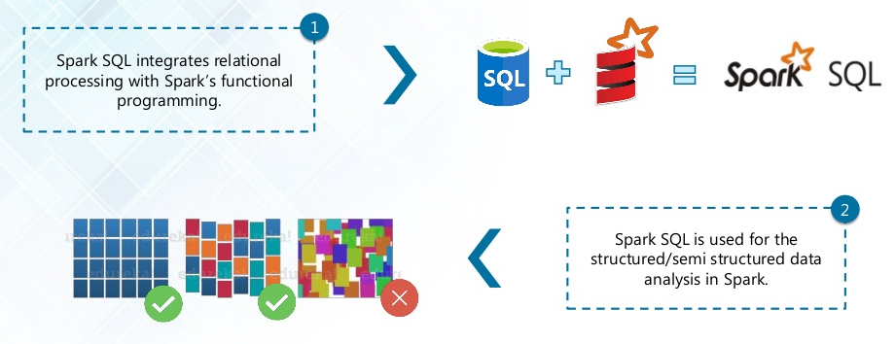
Spark SQL Features
Reference: Spark SQL Reference
Notes:
Integrated
Seamlessly mix SQL queries with Spark programs.
Spark SQL lets you query structured data inside Spark programs, using either SQL or a familiar DataFrame API. Usable in Java, Scala, Python and R.

Slide 57
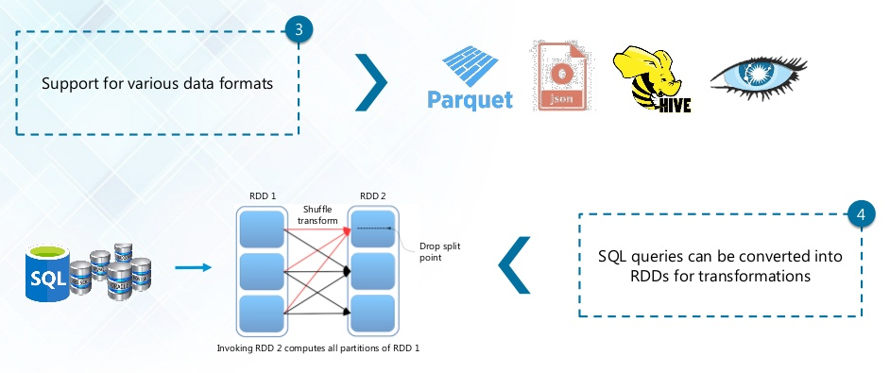
Spark SQL Features
Notes:
Uniform Data Access
Connect to any data source the same way.
DataFrames and SQL provide a common way to access a variety of data sources, including Hive, Avro, Parquet, ORC, JSON, and JDBC. You can even join data across these sources.
Hive Integration
Run SQL or HiveQL queries on existing warehouses.
Spark SQL supports the HiveQL syntax as well as Hive SerDes and UDFs, allowing you to access existing Hive warehouses.

Slide 58
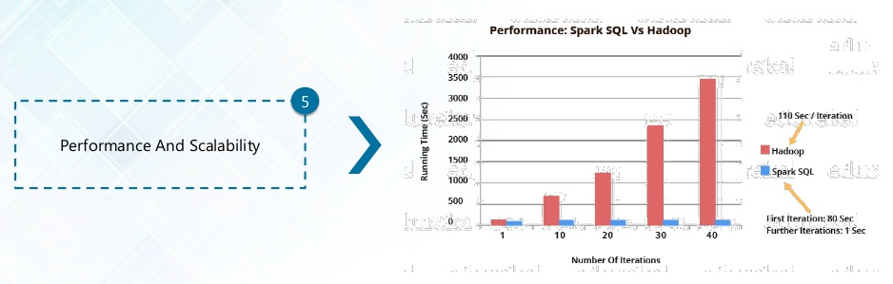
Spark SQL Features
Notes:
Performance & Scalability
Spark SQL includes a cost-based optimizer, columnar storage and code generation to make queries fast.
At the same time, it scales to thousands of nodes and multi hour queries using the Spark engine, which provides full mid-query fault tolerance.
Don't worry about using a different engine for historical data.

Slide 59
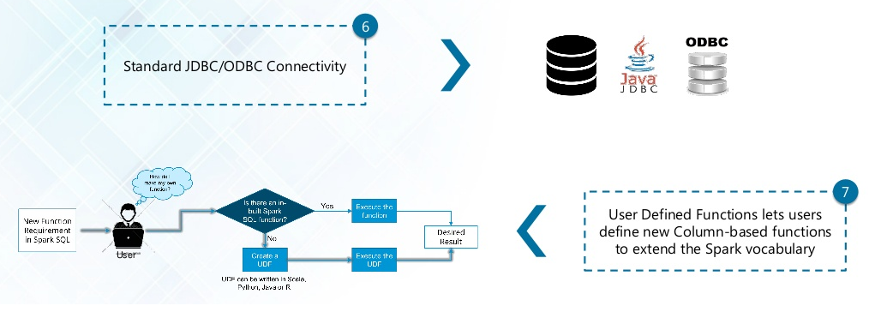
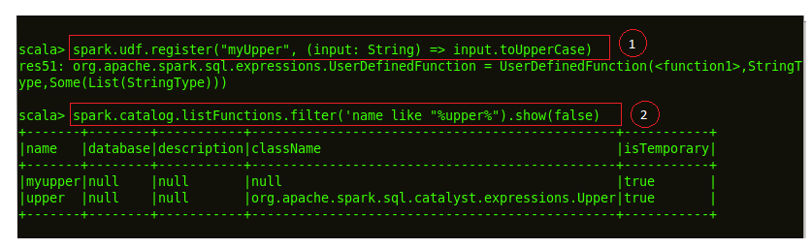
Spark SQL Features
Notes:
Standard Connectivity
Connect through JDBC or ODBC.
A server mode provides industry standard JDBC and ODBC connectivity for business intelligence tools.

Slide 60
Spark Essentials: RDD Fault Tolerance

